Slide 1
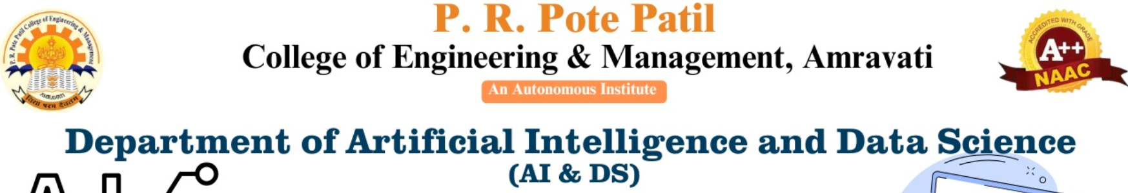

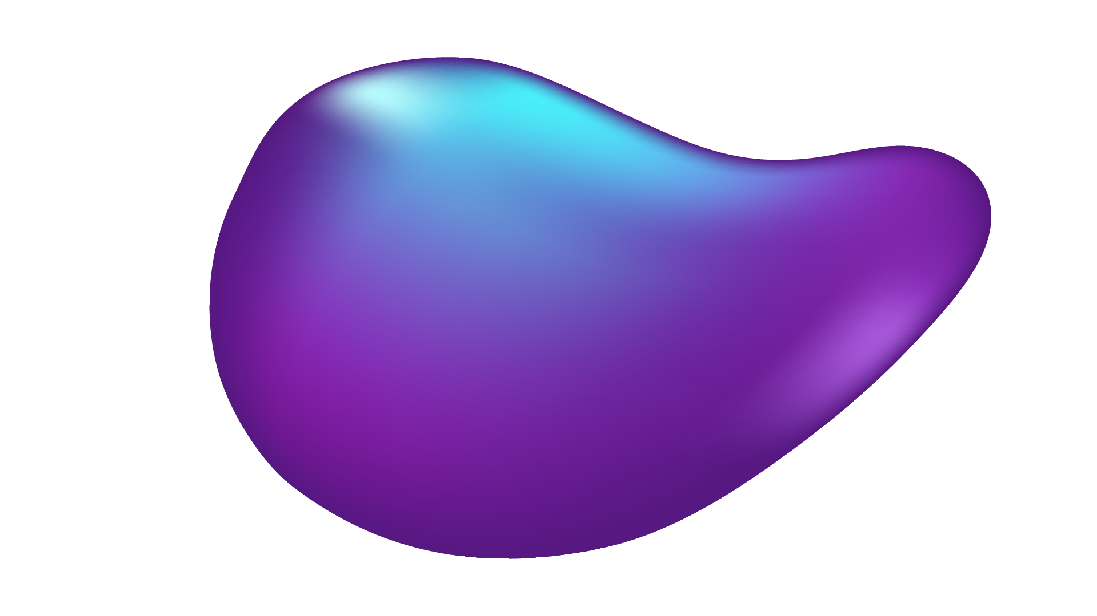
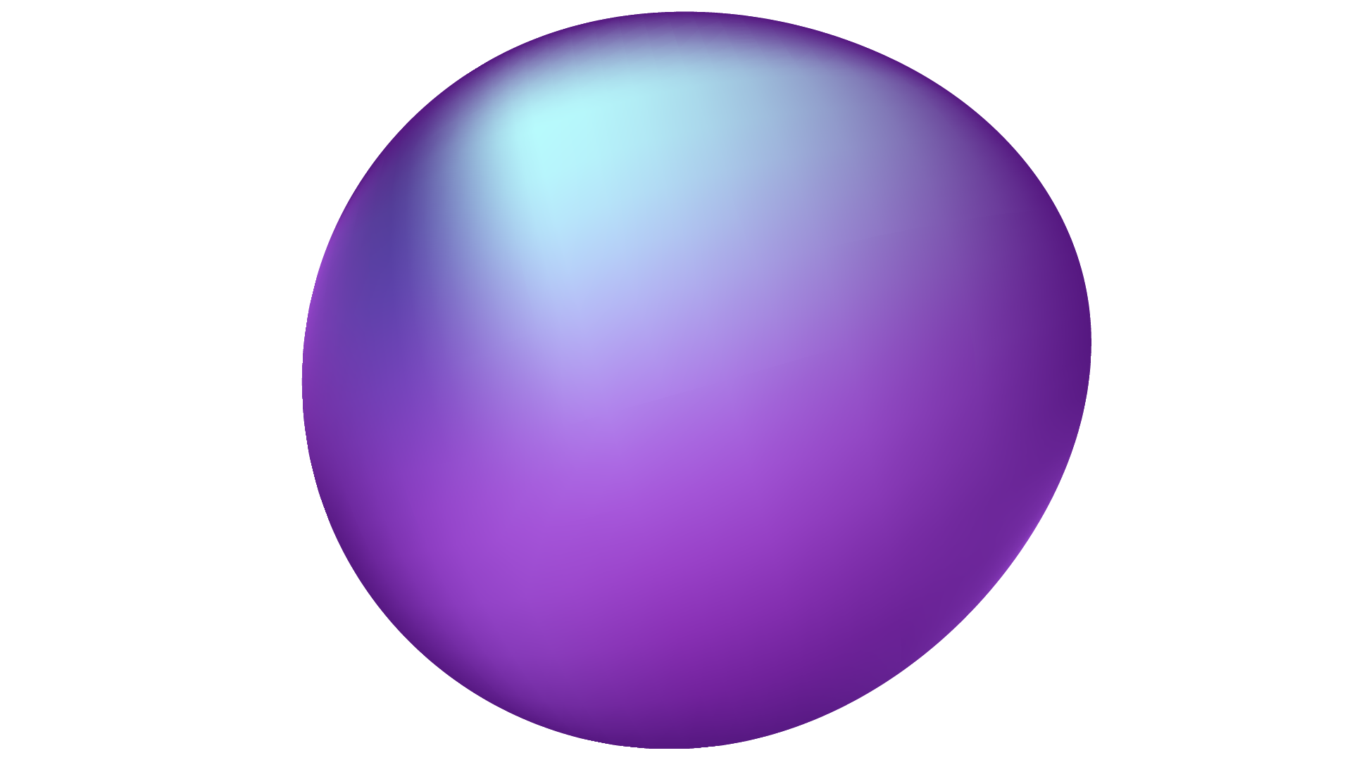
Implementation of a Simple Expert System for Medical Diagnosis
Team Members:
25 - Tejshree R. Bambal
72 - Radhika K. Chavan
73 - Radhika N. Gawande
76 - Vaishnavi M. Chauhan
77 - Yash S. Gawande
Project Guide : Dr. P.G. Angaitkar

Slide 2
Structured explanation of the app
Mobile health assistant application
Combines image recognition and symptom-based chatbot
Bridges gap in medical information accessibility
Empowers users with instant, reliable health insights

Slide 3
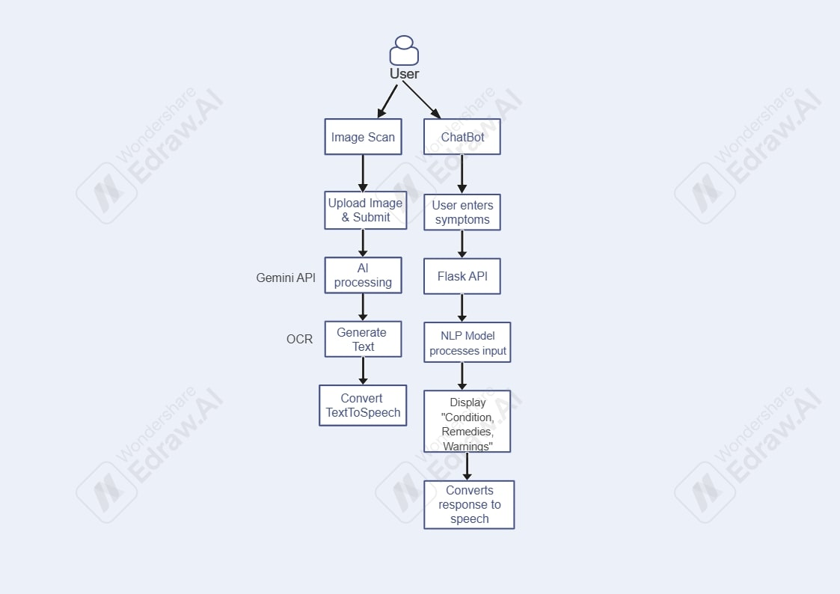
System Architecture

Slide 4
Algorithm and Algorithms Work
OCR Algorithm
Optical Character Recognition
Precise medical text extraction
Gemini API-powered parsing
NLP Chatbot Algorithm
Hybrid Approach (Rule-based + Machine Learning)
Context-aware symptom processing
Dynamic response generation
Intelligent information retrieval

Slide 5
Project Goal
Primary Objectives
Enhance Medical Information Accessibility
Provide Instant Health Guidance
Simplify Complex Medical Information
Improve Health Literacy
Create User-Friendly Healthcare Assistant
Success Metrics
Accuracy of medical information extraction
Relevance of chatbot responses
User engagement and satisfaction
Ease of use

Slide 6
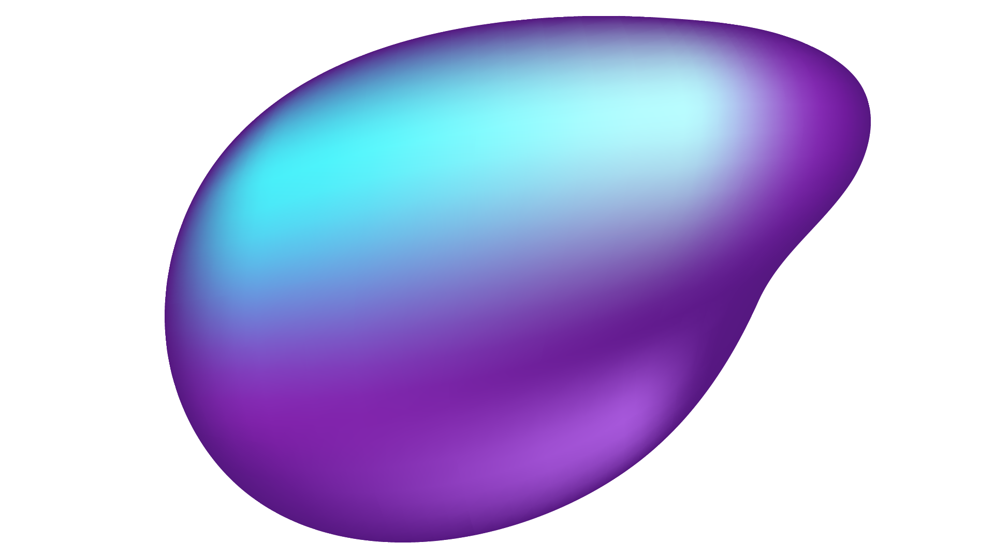
Library
Mobile Development
Backend
Python, Flask
Pandas
Kotlin
Android SDK
NLP Libraries
NLTK ,Tokenization ,
Stemming ,
Stopword Processing,
Regular Expressions
Data Processing & API’s
Pandas
Unicode Normalization
Gemini API
TTS

Slide 7
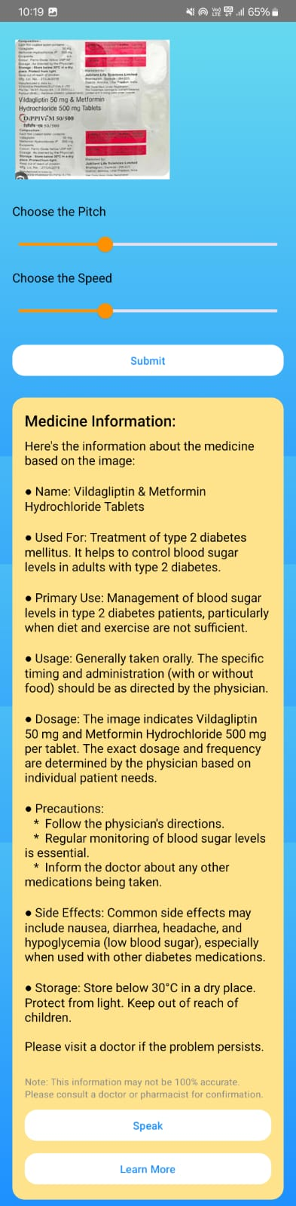
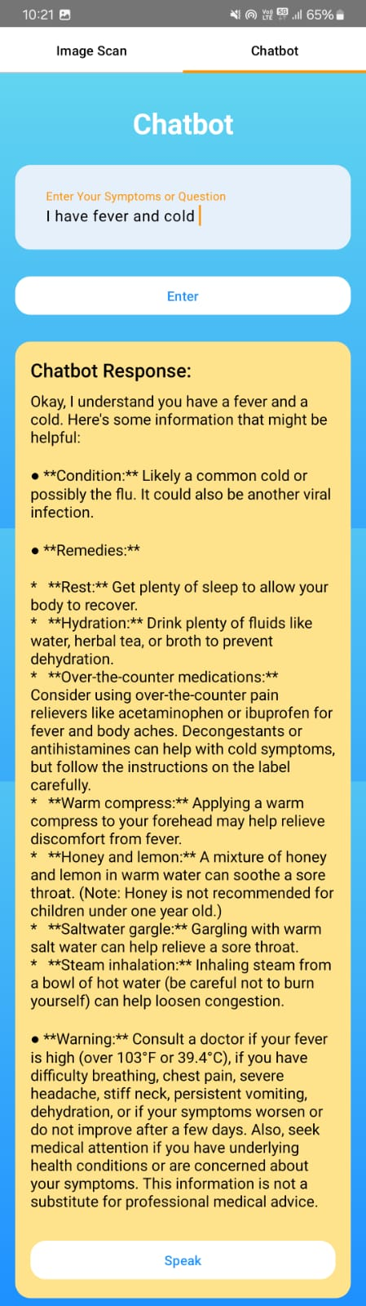
Output

Slide 8
Conclusion
Developed a Mobile Health Assistant with image recognition & a symptom-based chatbot.
Improved medical information accessibility & health literacy.
Used OCR & NLP algorithms for accurate text extraction & analysis.
Future scope: enhanced chatbot accuracy & multilingual support.

Slide 9
Thank-You!!

